Slide 1
AAUW of Oregon
How to be an Effective
Lobby Days Advocate
March 13, 2025

Slide 2
What We Will Cover
The Teams
The purpose and scope of Lobby Days
How to conduct your meetings
How to talk about our bills
The logistics

Slide 3
First, a few stats…
44 people are registered for Lobby Days.
12 branches are participating:
Portland Baker City Astoria Grants Pass Seaside Online Lincoln City Lake Oswego Salem Hillsboro-Forest Grove Gresham Pendleton

Slide 4
The Teams
Teams have been formed based on shared legislators in branches.
We have tried to keep branch members together where possible.
A team leader has been designated for each team.

Slide 5
Team Leader Responsibilities
Each team has a designated Team Leader (TL). TL responsibilities:
Be the point of contact for all communications with the Lobby Days committee.
Contact your Team members and confirm that they are available on the scheduled dates and times.
Decide what Team members are assigned to present the 6 bills.
Meet with Team members before your meeting to make sure everyone knows their role.
Take the lead in presenting the Team members and our bills to the Legislator or his/her staff.
Send a “Thank you” email to the legislator or staff that you met with.
Help us track the success of Lobby Days by completing a “Visit Evaluation” form.

Slide 6
Purpose and Scope of Lobby Days
Great opportunity to:
Acquaint yourself with your legislators
Acquaint your legislators with AAUW, AAUW Oregon, and your branch
Advocate on behalf of AAUW Oregon’s top six priority bills for 2025

Slide 7
The Meetings
Meetings will last about 15 minutes.
Team Leader makes introductions, presents overview of AAUW, AAUW of Oregon, and leader’s branch.
Other team members give overview of their branch if in district.
Members explain their assigned bill, and ask for a commitment of support.
Team Leader thanks the legislator or staff, gets contact info for follow-up.

Slide 8
Proposed Script For Lobby Day - Team Leader
Good [morning][afternoon]. On behalf of AAUW of Oregon, we want to thank you so much for giving us the opportunity to meet with you today. My name is [ ]. I am from the [ ] branch of AAUW, and these are my colleagues [introduce each or let them introduce themselves, with branch name].
I’d like to take a few minutes to tell you about AAUW, the American Association of University Women, but may I ask first if you are familiar with our organization? (Give them a chance to tell you what they might already know – don’t waste time on info they already have, just fill in whatever is missing) – highlights:
Nationwide organization started in 1881
Headquartered in Wash D.C., affiliates in all 50 states, including Oregon
We are known as AAUW of Oregon. We were organized in 1924. We currently have 21 branches and over 850 members.
Our mission is to advance equity for women and girls through research, education, and advocacy, and our values include ensuring equity for a diverse society

Slide 9
Proposed Script For Lobby Day - Team Leader (cont’d)
Our branch is in your/the member’s district, and [if appropriate] we appreciate the support you/the member has shown for issues we care about. I’d like to tell you a little about the things our branch is doing for your/the member’s community [highlights of current/recent events]. Make it short.
Can I answer any questions for you about AAUW?
Every year, AAUW Oregon sets a legislative agenda of bills that we are supporting. We have chosen six that we’d like to talk to you about today, and at this point I will turn it over to my colleagues, each of whom will address one of our bills.

Slide 10
Proposed Script For Lobby Day - Team Member
I’d also like to thank you for giving us the opportunity to talk to you today.
I’d like to talk to you today about [Bill No.] [Refer to talking points.]
Do you have any questions for me about [Bill No.]? [If you can answer, do so. If you can’t answer, say: I’m not sure about that, but I will definitely have someone from our state public policy team get back to you with an answer right away.
May I indicate that AAUW will have your support for [Bill No.]? [If they say “no” don’t argue, just ask them if they would mind sharing their concerns, then write them down.]
[Each member will repeat in turn.]

Slide 11
Proposed Script For Lobby Day Team Leader - Closing
Thank you again so much for your time and attention.
[If you are meeting with the legislator]: Can you give me the name and contact for the person we should send follow-up responses and material to?
[If you are meeting with a staffer]: Can you spell your name and give me your contact info so we can send responses and material to you?

Slide 12
Some Do’s … Before the Meeting
Do some homework - know where the member stands on the AAUW values, if possible.
Make sure you understand the bills. Review the talking points and ask if you’re not sure.
Most of you will be on Zoom. Make sure your equipment is working and there are no distractions.

Slide 13
During the Meeting
RELAX! They’re just people!
Let them know if you are a constituent.
Let your pride in AAUW shine through.
Stick to your allotted time.
It’s okay to read from the talking points.
Give them time to ask questions and listen carefully to responses.
It’s okay to say “I don’t know.” Tell them you’ll find out and that someone will circle back. WRITE IT DOWN!
Ask if we can count on the member’s support.

Slide 14
Some Don'ts
If you have been a campaign contributor DO NOT MENTION IT!
Don’t be late. Check in a few minutes ahead of time to avoid computer glitches.
If the legislator is about to speak or is speaking, do not interrupt.
Don’t ramble.

Slide 15
Some “Don’t Forgets”
Designate someone to take a picture of the screen.
Be flexible.
We may have last-minute changes beyond our control.
Your member or staffer may be late.
Your member or staffer may have to cut the meeting short.
There may be technical glitches.
Be courteous no matter what.
Get contact info.
Make note of questions/concerns/responses.
Send a thank you email.

Slide 16
Questions

Slide 18
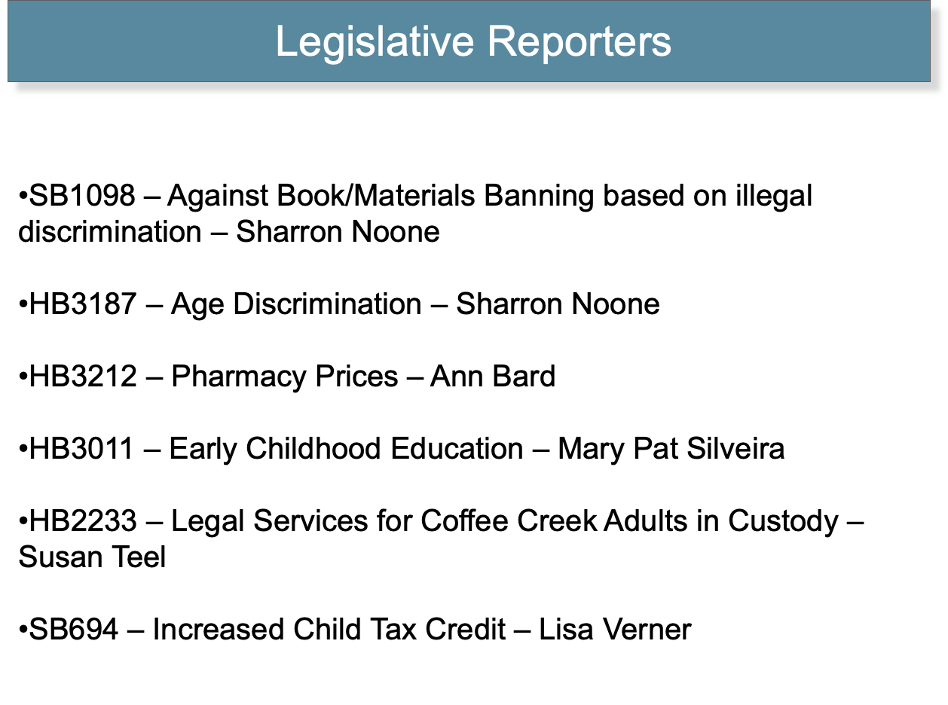

Slide 20
HB 3187 - Anti Age Discrimination
What the bill says: 1. When bringing a claim based on workplace age discrimination, the definition of “age” may include salary, length of service and retirement or pension status. 2. Prior to an initial interview or making a conditional offer of employment, employers can’t require disclosure of the applicant’s age or when the applicant attended or graduated from any educational institution. 3. Employers can’t reject an apprenticeship because the apprentice will be age 70 or more when completing the apprenticeship. NOTE: This is a minor and totally uncontested part of the bill so there’s no need to mention it. The federal government has mandated that the Bureau of Labor and Industries must follow this rule.
HB 3187 Anti Aging Discrimination

Slide 21
Talking Points:
HB 3187 takes a narrow approach in closing up a loophole in Oregon law by providing that evidence of salary, length of service and pension/retirement status can be used to establish a claim for workplace age discrimination. While these factors don’t establish a claim in and of themselves, claimants should be able to present this evidence to the court when proving their case.
EXCEPTION: HB 3187 explicitly allows employers to take an employment action that uses these factors if it is in accordance with a seniority system or employee benefit plan.
Before an initial interview or making a conditional offer of employment, employers can’t require disclosure of the applicant’s age or graduation dates. They may, however, ask that information when it is needed to ensure the applicant meets the specific job requirements.
It’s time that those discriminated against by age be given as fair a shot at proving their case as those who try to prove discrimination based on gender and race.
HB 3187 - Anti Age Discrimination

Slide 23
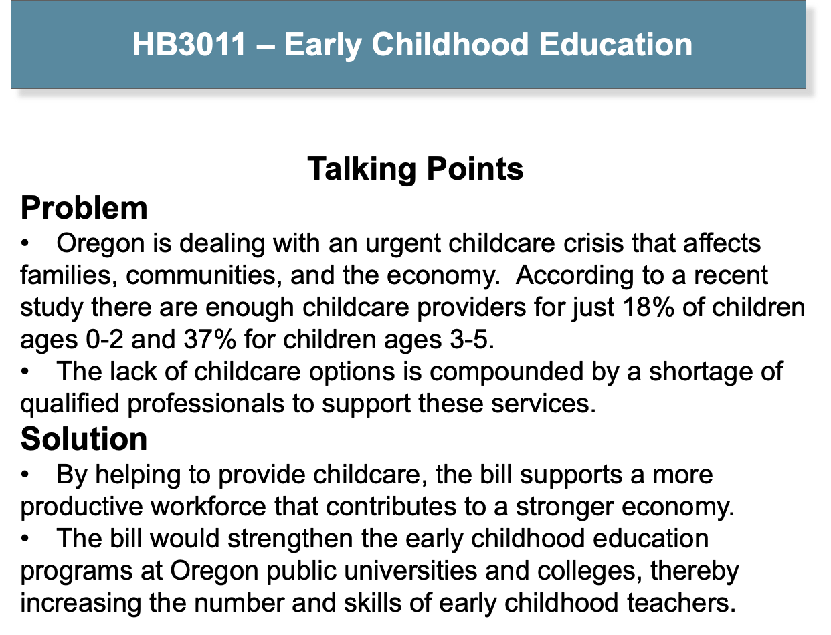

Slide 26
Important Bill Dates
March 21: Bills in one chamber need to be posted for a public hearing by this deadline or the bill dies.
April 9: Bills posted per March 21st need to be acted upon and leave the first chamber committee by this deadline or they die. (Remember that bills can go to the second chamber OR, if they have a significant fiscal—budget cost—they need to be sent to Ways and Means.)

Slide 27
Logistics - Before the Meeting
For those meeting in person, be ready to begin on time.
For those meeting on Zoom, all members should make sure they are familiar with Zoom and that equipment is in working order.
Questions about one of your legislators, or about any of your meetings?
Contact Claire Berger at 503-866-3560 and claire.berger248@gmail.com

Slide 28
Logistics - After the Meeting
Team Leaders, please complete the online visit evaluation form Lobby Days Visit Report for each meeting, no later than March 25, 2025. Please be sure to note any questions or requests for specific information that we will need to follow up on, so that we can respond and get that information to the legislator.
Team Leaders, please send a thank you email to the member/staffer that you met with.

Slide 29
Questions

